Slide 1

PRINCIPLES
of

Slide 2

Chapter 1 Introduction to Managers and Management

Slide 3
Managers and management
Managers
Someone who works with and through other people by coordinating and integrating their work activities in order to accomplish organizational goal.
Management
Is the process of planning, organizing, staffing, leading and controlling the organizational resources namely human, physical, informational and financial effectively and efficiently to achieve organizational goal.
Managerial concerns
Effectiveness:
Doing the right things
Attaining organizational goals
2. Efficiency:
Doing things right
Getting the most output of the least inputs

Slide 4
Management functions
Planning
Planning involves setting objectives and determining the course of action to achieve those objectives.
It includes identifying tasks, allocating resources, and establishing timelines.
Planning helps organizations anticipate future challenges and opportunities.
2. Organizing
Arranging and structuring work to accomplish organizational goals.
This function involves creating a structure, defining roles and responsibilities, and establishing communication channels.
The goal is to ensure that all necessary resources are available and properly utilized.
Determining what needs to be done, how it will be done and who is to do it.

Slide 5
3. Leading
Leading is about influencing and motivating people to achieve organizational goals.
It includes activities such as communication, motivation, team-building, and decision-making.
Effective leadership is crucial for fostering a positive work environment and inspiring employees.
4. Controlling
Controlling involves monitoring and evaluating ongoing activities to ensure that they are consistent with the organization's plans and goals.
This function includes setting performance standards, measuring actual performance, and taking corrective action when necessary.
Controlling helps organizations stay on track and make adjustments to achieve desired outcomes.

Slide 6
Management roles
Henry Mintzberg, a renowned management theorist, identified ten managerial roles that he classified into three main categories: interpersonal, informational, and decisional roles.
1. Interpersonal Roles:
Figurehead: The manager represents the organization and performs ceremonial duties.
Leader: Managers guide and motivate their teams, providing direction and support.
Liaison: Managers build and maintain networks both within and outside the organization.

Slide 7
2. Informational Roles:
Monitor: Managers constantly scan the internal and external environment for information that may affect the organization.
Disseminator: Managers share information within the organization, ensuring that relevant information is communicated to the right people.
Spokesperson: Managers convey information about the organization to external stakeholders.

Slide 8
3. Decisional Roles:
Entrepreneur: Managers initiate and oversee projects that bring about change and innovation.
Disturbance Handler: Managers address conflicts and crises within the organization.
Resource Allocator: Managers make decisions about the allocation of resources, such as budgeting and assigning tasks.
Negotiator: Managers engage in negotiations, both within the organization and with external parties.

Slide 9
Management skills
Managers need a diverse set of skills to effectively fulfill their roles and responsibilities. Henry Mintzberg, the management theorist, identified three broad categories of managerial skills:
1. Technical Skills:
Industry-specific knowledge: Managers should possess a solid understanding of the technical aspects related to their industry or field.
Analytical abilities: The capacity to analyze data, trends, and other information is crucial for making informed decisions.
Expertise in specialized areas: Depending on the organization and industry, managers may need specialized technical skills relevant to their domain.

Slide 10
2. Interpersonal Skills:
Communication: Effective communication is essential for conveying ideas, instructions, and feedback clearly. It also involves active listening.
Leadership: The ability to lead and motivate teams is crucial for achieving organizational goals. This includes providing guidance, support, and inspiration.
Conflict resolution: Managers must be adept at resolving conflicts and fostering a positive work environment.

Slide 11
3. Conceptual Skills:
Strategic thinking: Managers need to understand the organization's overall goals and develop strategies to achieve them.
Problem-solving: The capacity to analyze complex situations and develop creative solutions is vital for managerial success.
Decision-making: Managers make a multitude of decisions daily, ranging from routine operational choices to strategic decisions with long-term consequences.

Slide 12
In addition to Mintzberg's framework, other important skills for managers include:
1. Time Management:
The ability to prioritize tasks and manage time effectively is crucial for meeting deadlines and ensuring that organizational objectives are achieved.
2. Emotional Intelligence:
Managers with high emotional intelligence can understand and manage their own emotions and those of others, fostering better interpersonal relationships and leadership effectiveness.
3. Adaptability:
In a dynamic and ever-changing business environment, managers must be adaptable and open to change. This includes being flexible in their approach to problem-solving and decision-making.
4. Networking:
Building and maintaining professional networks both within and outside the organization can be valuable for gathering information, seeking advice, and fostering collaboration.

Slide 13
Historical Background of Management
Ancient Management
Egypt (pyramids) and China (Great Wall)
Venetians (floating warship assembly lines)
Adam Smith
Published “The Wealth of Nations” in 1776
Advocated the division of labor (job specialization) to increase the productivity of workers
Industrial Revolution
Substituted machine power for human labor
Created large organizations in need of management

Slide 14
Major Approaches to Management
Scientific Management
General Administrative Theory
Quantitative Management
Organizational Behavior
Systems Approach
Contingency Approach

Slide 15
Scientific Management
Fredrick Winslow Taylor
The “father” of scientific management
Published Principles of Scientific Management (1911)
The theory of scientific management
Using scientific methods to define the “one best way” for a job to be done:
Putting the right person on the job with the correct tools and equipment.
Having a standardized method of doing the job.
Providing an economic incentive to the worker.

Slide 16
Taylors principles
Science not rule of thumb: Develop a science for each element of an individual’s work, which will replace the old rule-of-thumb method.
Harmony not discord
Cooperation not individualism
Development of workers to their greatest ability

Slide 17
Scientific Management (cont’d)
Frank and Lillian Gilbreth
Focused on increasing worker productivity through the reduction of wasted motion
Developed the microchronometer to time worker motions and optimize work performance
How Do Today’s Managers Use Scientific Management?
Use time and motion studies to increase productivity
Hire the best qualified employees
Design incentive systems based on output

Slide 18
General Administrative Theory
Henri Fayol
Believed that the practice of management was distinct from other organizational functions
Developed fourteen principles of management that applied to all organizational situations
Max Weber
Developed a theory of authority based on an ideal type of organization (bureaucracy)
Emphasized rationality, predictability, impersonality, technical competence, and authoritarianism

Slide 19
Fayol’s 14 Principles of Management
Division of work.
Authority.
Discipline.
Unity of command.
Unity of direction.
Subordination of individual interests to the general interest.
Remuneration.
Centralization.
Scalar chain.
Order.
Equity.
Stability of tenure of personnel.
Initiative.
Esprit de corps.

Slide 20
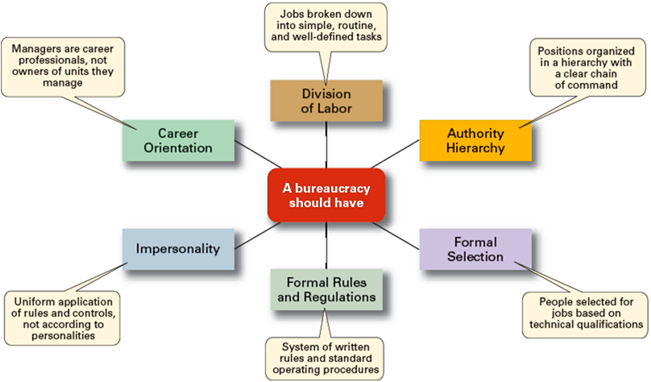
Weber’s Ideal Bureaucracy

Slide 21
Quantitative Approach to Management
Quantitative Approach
Also called operations research or management science
Evolved from mathematical and statistical methods developed to solve WWII military logistics and quality control problems
Focuses on improving managerial decision making by applying:
Statistics, optimization models, computer simulations, plant location and design, layout, inventory management, quality control etc.

Slide 22
Understanding Organizational Behavior
Organizational Behavior (OB)
The study of the actions of people at work; people are the most important asset of an organization
Early OB Advocates
Robert Owen
Hugo Munsterberg
Mary Parker Follett
Chester Barnard

Slide 23
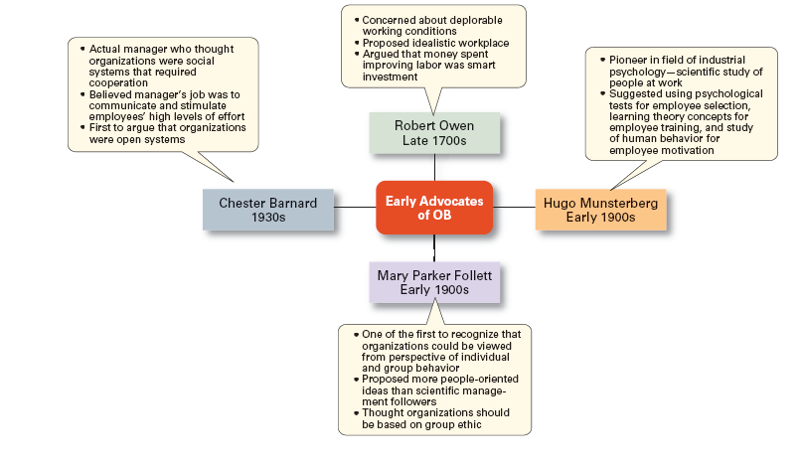

Slide 24
The Systems Approach
System Defined
A set of interrelated and interdependent parts arranged in a manner that produces a unified whole.
Basic Types of Systems
Closed systems
Are not influenced by and do not interact with their environment (all system input and output is internal).
Open systems
Dynamically interact to their environments by taking in inputs and transforming them into outputs that are distributed into their environments.

Slide 25
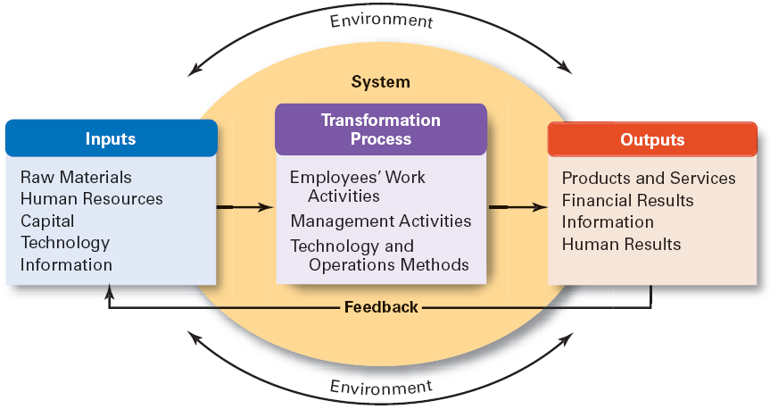
Exhibit 2–6 The Organization as an Open System

Slide 26
Implications of the Systems Approach
Coordination of the organization’s parts is essential for proper functioning of the entire organization.
Decisions and actions taken in one area of the organization will have an effect in other areas of the organization.
Organizations are not self-contained and, therefore, must adapt to changes in their external environment.

Slide 27
The Contingency Approach
Contingency Approach Defined
Also sometimes called the situational approach.
There is no one universally applicable set of management principles (rules) by which to manage organizations.
Organizations are individually different, face different situations (contingency variables), and require different ways of managing.

Slide 28
Exhibit 2–7 Popular Contingency Variables
Organization size
As size increases, so do the problems of coordination.
Routineness of task technology
Routine technologies require organizational structures, leadership styles, and control systems that differ from those required by customized or nonroutine technologies.
Highly complex task and technologies may require more flexible and adaptive management styles as well as decentralization.
Environmental uncertainty
What works best in a stable and predictable environment may be totally inappropriate in a rapidly changing and unpredictable environment.
Managers may need to be more adaptive and responsive
Individual differences
Individuals differ in terms of their desire for growth, autonomy, tolerance of ambiguity, and expectations.

